Slide 1
Give Us clean hands by Charlie hall

Slide 2
We bow our hearts,
We bend our knees
Oh Spirit,
Come make us humble

Slide 3
We turn our eyes,
From evil things
Oh Lord,
We cast down our idols

Slide 4
Give us Clean Hands,
Give us Pure Hearts
Let us not lift our souls
To another

Slide 5
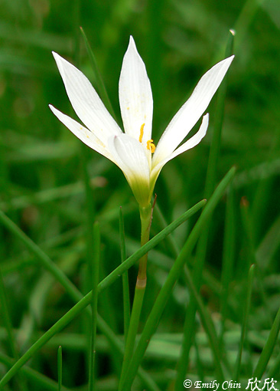
….Clean Hands,
..Pure Hearts
Let us not lift our souls
To another

Slide 6
And O God,
Let us be a generation that seeks,
That seeks Your face, O God of Jacob

